Slide 1



Safecommute TEAM Code Commuters Devcon Hackthon March 1, 2025
Notes:
Hello everyone, we are team code commuters and this is our submission to the devcon hackathon:

Slide 2

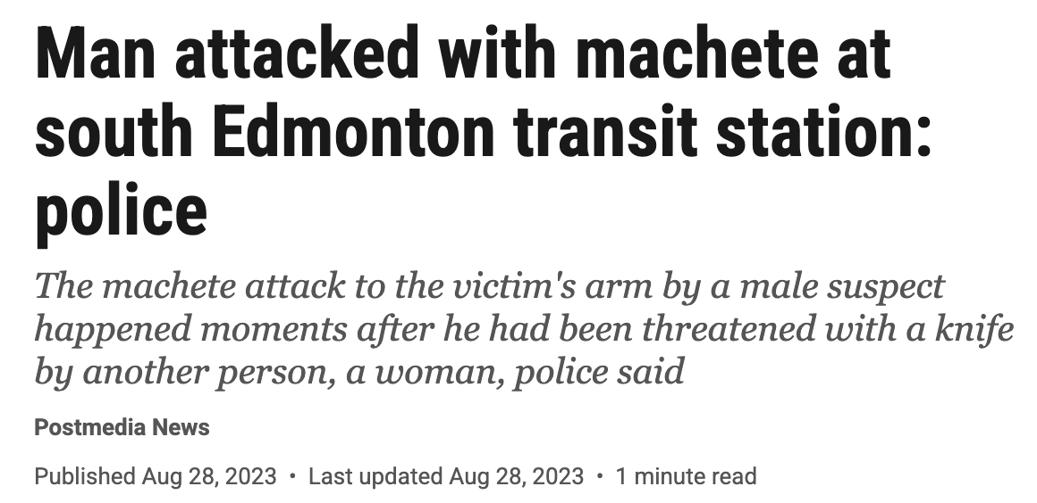
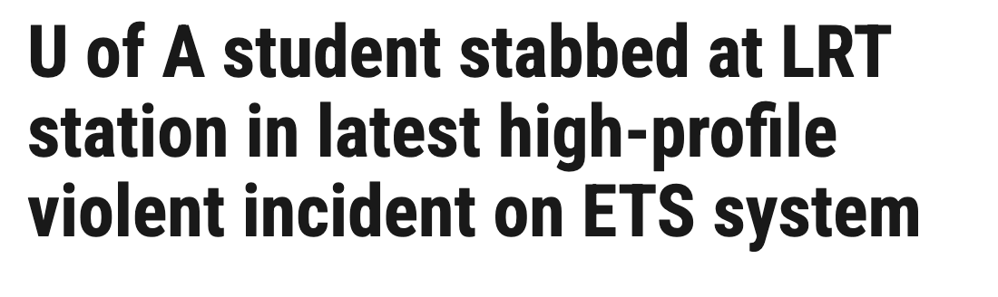
Real World Issue:
Notes:
Unfortunately, Edmonton had recent incidents in 2021 and 2023 involving weapons on ETS, even if rare, commands public sentiment and therefore transit ridership.

Slide 3
Improving Public Transit Safety:
Increasing safety concerns among riders.
Low reporting rates for incidents or suspicious activities.
Delayed response times from authorities.
https://edmonton.citynews.ca/2024/09/26/edmonton-safety-public-transit-poll/
Notes:
According to a city news poll in 2024, 75% of Edmontonian don’t feel safe taking public transit. This lack of security leads less people to feel confident in taking public transit daily. Additionally, contemporary solutions are typically focused on post-incident remediation, rather than real-time intervention. Furthermore, the bystander effect limits the public’s ability to intervene. Edmontonians deserve safe public transit, so let’s see our solution:
https://edmonton.citynews.ca/2024/09/26/edmonton-safety-public-transit-poll/

Slide 4

SafeCommute AI-Powered Threat Detection for Transit Safety
Notes:
Our solution is Safecommute: an AI-powered threat detection system for transit safety

Slide 5






The Team:
JP Cooper
Oliver Chen
William Ma
Manav Joshi
Rishit Gajjar
Robert Lu
Notes:
My name is (insert name) Spanning a diverse set of undergraduate to graduate and disciplines from pharmaceutical sciences to electrical engineering, we were thrilled to tackle this hackathon.

Slide 6
Safecommute:
An AI-driven software solution that enhances existing CCTV infrastructure reducing cognitive load
Automatically identify threats like weapons or fights.
Real-time alerts to transit authorities when potential threats are detected.
Seamlessly integrates with existing camera infrastructure for minimal disruption.
https://www.americancityandcounty.com/artificial-intelligence/chicago-s-transit-authority-looks-to-ai-powered-gun-detection-to-help-curb-violent-crime
Notes:
Safecommute builds on existing 1,100 CCTV camera infrastructure which uses computer vision to automatically identify threats such as weapons or violence.
These real-time alerts will notify transit authorities for a timely response. By integrating with existing infrastructure, our machine-learning powered threat detection system is modelled after currently deployed systems such as Ch icago’s ZeroEyes’s system.
https://www.americancityandcounty.com/artificial-intelligence/chicago-s-transit-authority-looks-to-ai-powered-gun-detection-to-help-curb-violent-crime

Slide 7
SAFECOMMUTE Demo:
Notes:
Let’s take a look at how safecommute works!

Slide 8
SAFECOMMUTE: Utility
Real-time threat detection
Bypasses bystander effect
Cost-effective solution
Social & environmental impact
Global relevance
Notes:
SafeCommute gives transit authorities a proactive security tool that improves public trust and emergency response times. Unlike passive surveillance, our AI actively detects threats and alerts security in real time, enabling faster intervention and preventing escalation. By automating key parts of threat detection, we eliminate bystander hesitation, ensuring all risks are flagged. Ultimately, SafeCommute makes public transit safer, more accessible, and more reliable.

Slide 9
SAFECOMMUTE: IMPACT
Safety
Convenience
Cost
BENEFITS
End-user
ETS & CoE
Notes:
Safe commute has a broad impact across 3 priority areas; cost, convencience, and safety for both the transit user and service provider.

Slide 10
SAFECOMMUTE: Cost Analysis
Monthly Operational Costs: $53,000
One-Time Setup Costs: $30,000
Notes:
"Now, let’s go over the cost structure for SafeCommute and how we’ve optimized our budget for efficiency while maintaining high performance.
Our one-time setup cost of $30,000 covers cloud integration, system configuration, and infrastructure for seamless deployment.
Monthly operational costs total $53,000, covering cloud computing, storage, bandwidth, security compliance, and API management to ensure reliable, scalable operation.
By optimizing resources, we provide a sustainable, real-time safety solution that enhances transit security while remaining cost-effective."

Slide 11
THANK YOU
Join Us in Creating
A Safe Transit Environment
Questions?
Notes:
Our ask is to help us to connect with ETS decision markers in the city to improve safe transit for everyone

